Slide 1
Organ Transplants

Slide 2

Sometimes our organs don’t work properly.
This can be because of an illness or just something the person was born with.

Slide 3
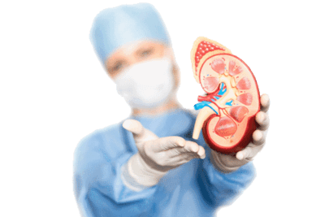
When this happens, doctors will decide if they can replace the organ with a healthy one from someone else.
This is called an organ transplant.

Slide 4
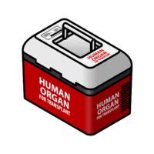
There are numerous organs that can be transplanted within the human body.
Some of these include the heart, lungs, liver, kidneys, intestine and pancreas.

Slide 5
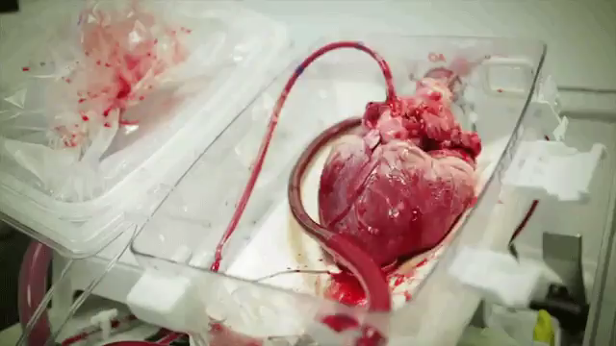
Take a look at the cool giphy below of a heart waiting to be transplanted! Hope you're not squeamish!

Slide 6
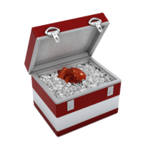
Where do these transplanted organs come from?
Well, organs can be transplanted from either living or deceased donors.

Slide 7
An organ donor is a person who gives or donates an organ.
There are two types of donors:
1. | Living donors
2. | Deceased donors

Slide 8
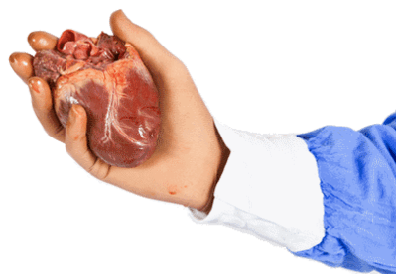
Tissues and organs can be donated by living donors.
These can only be donated if the tissues and organs can regrow or the organ is not needed.

Slide 9
Humans are usually born with two functioning kidneys, however, we are able to survive with only one. This means that one kidney can be donated to someone in need.
The remaining kidney will grow slightly larger and take over the function of the one that was donated. How amazing is the human body?!

Slide 10

Most organs used for transplants are taken from people who have passed away. These are known as deceased donors.
However, this can only happen is the person in question is registered as an organ donor or their family agrees with the procedure.

Slide 11

The only issue with deceased donors is that the organs must be transferred before they start to break down.
This can start happening within 40 minutes!

Slide 12
If recovered in time and stored correctly, kidneys can be kept up to 24 hours before transplantation and hearts can be kept up to 4 hours!

Slide 13
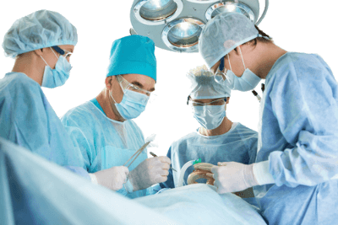
How do the donated organs get inside a person?
Through surgery! Transplant surgery is performed under general anaesthesia. This is when a person is completely unconscious and unable to feel pain during medical procedures.

Slide 14
 | There are numerous people who contribute to the smooth running of organ transplant operations.
Surgeons, doctors, nurses and other healthcare professionals play an important role in organ donation.

Slide 15
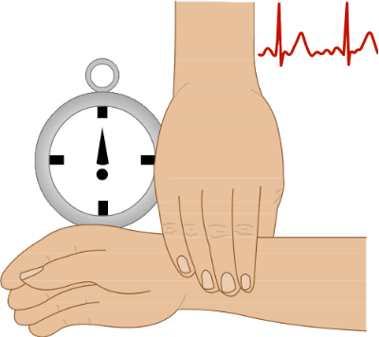
Doctors and nurses initiate a clinical evaluation of the potential donor.
They regulate the potential donor’s heart rate, body temperature and many other functions.

Slide 16

Medical Scientists and Laboratory Technicians play a role in the organ donation process. They run tests and compile data on the potential donor.
This determines whether an individual's organ is suitable for donation.

Slide 17
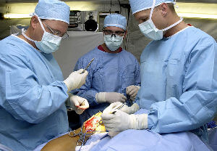
Once a potential donor has been given the tick of approval from the previously mentioned health professionals, they are then handed over to the surgeons.
A surgeon is a doctor who performs operations, in this case, organ transplantations.

Slide 18

Hospital support staff ensures the entire donation process runs smoothly. After the operation is complete, nurses make sure the patient makes a full recovery.
Support on every level makes a successful donation possible.

Slide 19
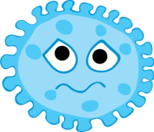


The immune system of an organism is a system of many biological structures and processes that protect against disease.

Slide 20

When one body system is down, the immune system comes into play.
Our immune system is like the tightrope walker on the high wire as it is constantly balancing and navigating the fine line between under and over reaction to external challenges.

Slide 21

Our immune system is our body's natural defence system. A network of cells, tissues and organs work together to protect our bodies from bacteria, viruses, parasites and even a fungus - these all have the potential to make us sick!

